Slide 1
Digital Marketing Plan for ROYBI

Slide 2
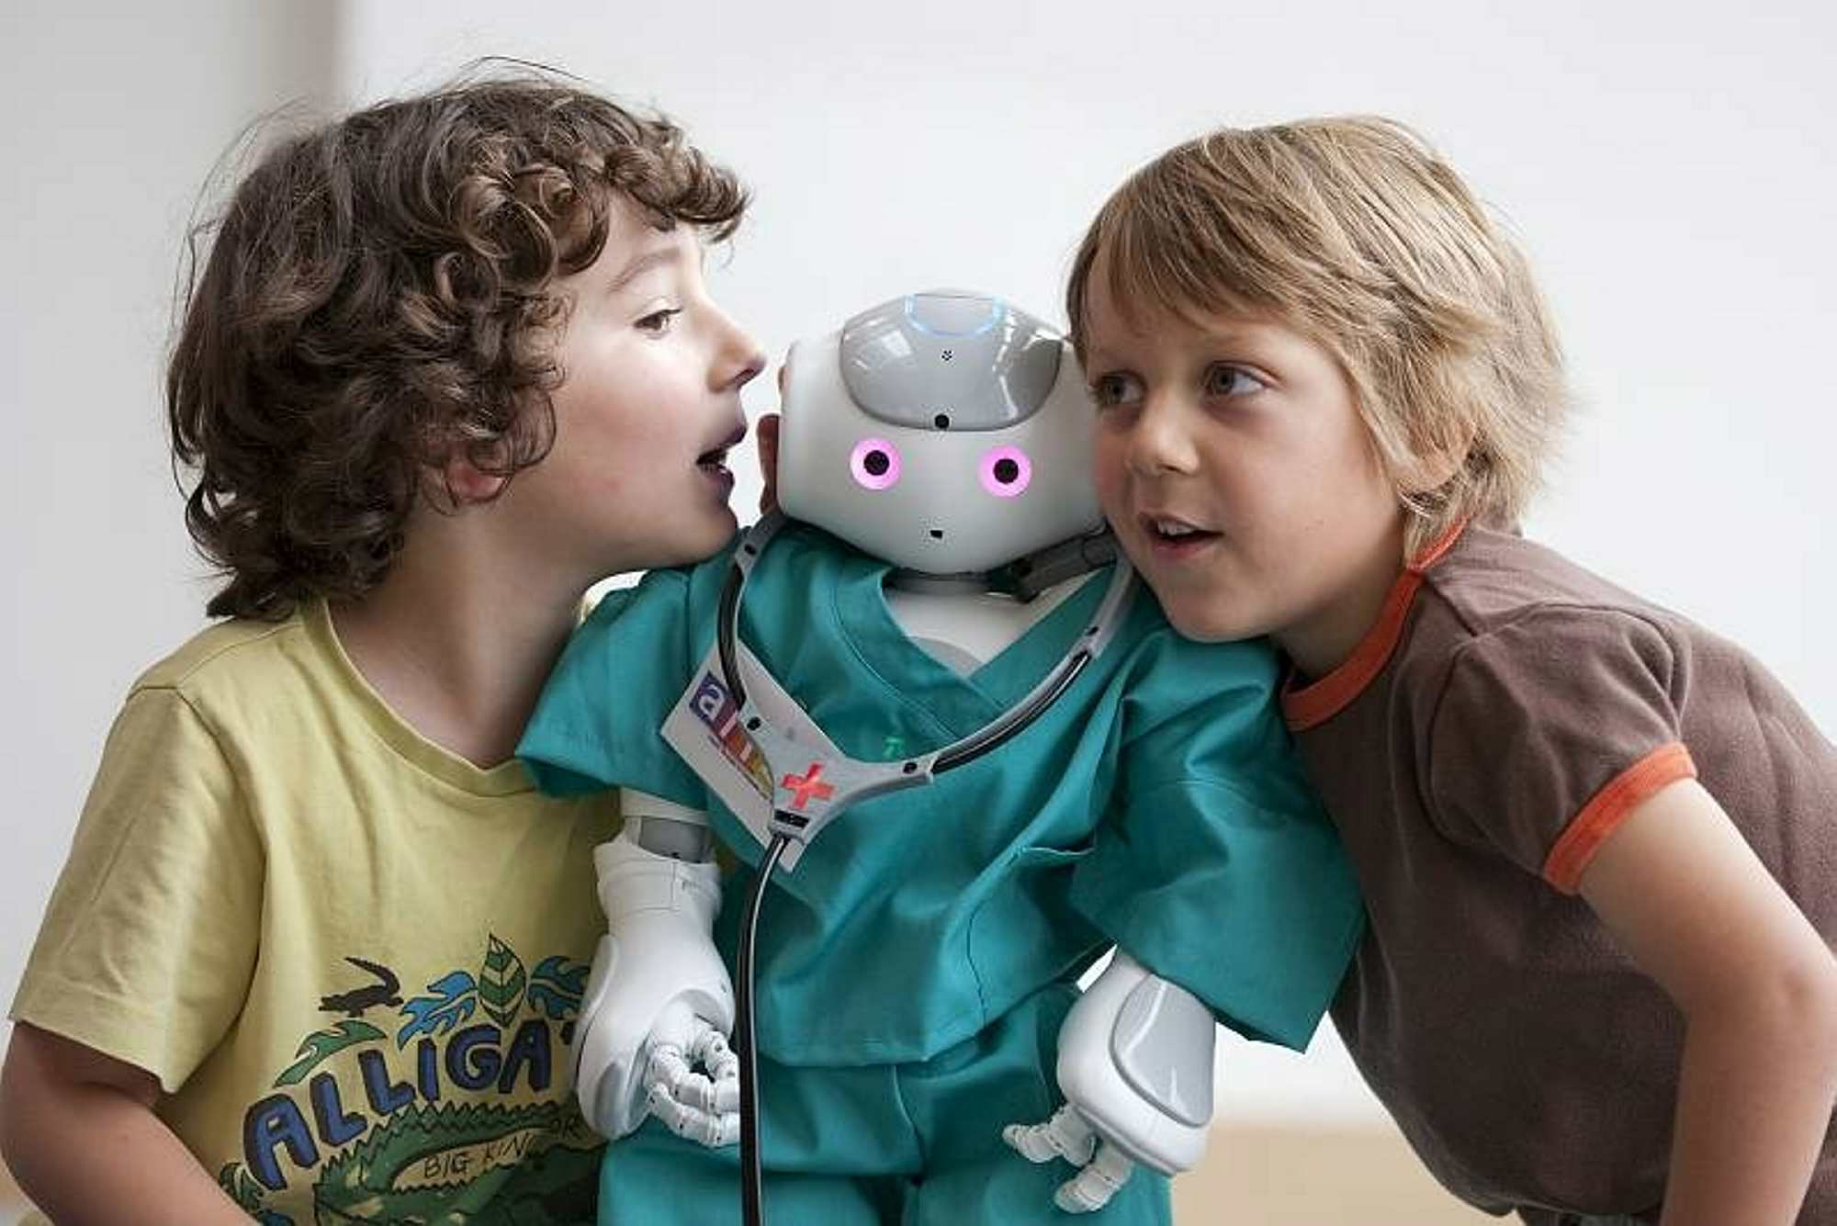
Product Introduction & Brief Recap
ROYBI , a young startup in kids AI language learning industry;
Total: Open Budget
Test : $10/day
Company
Budget
ROYBI Robot:
An AI Language Learning
robot for 3-7 year old kids ($299)
New product launching Period:
2019.OCT-2019.DEC
Product
Period

Slide 3
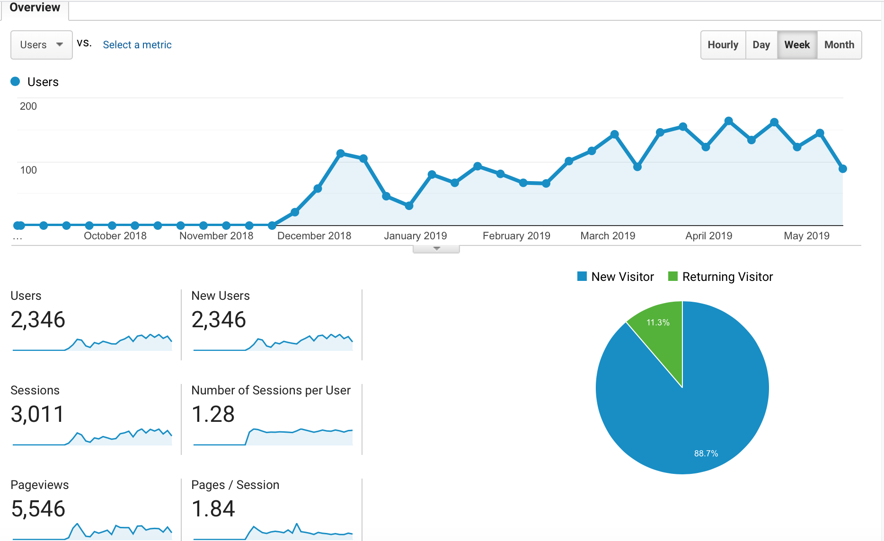
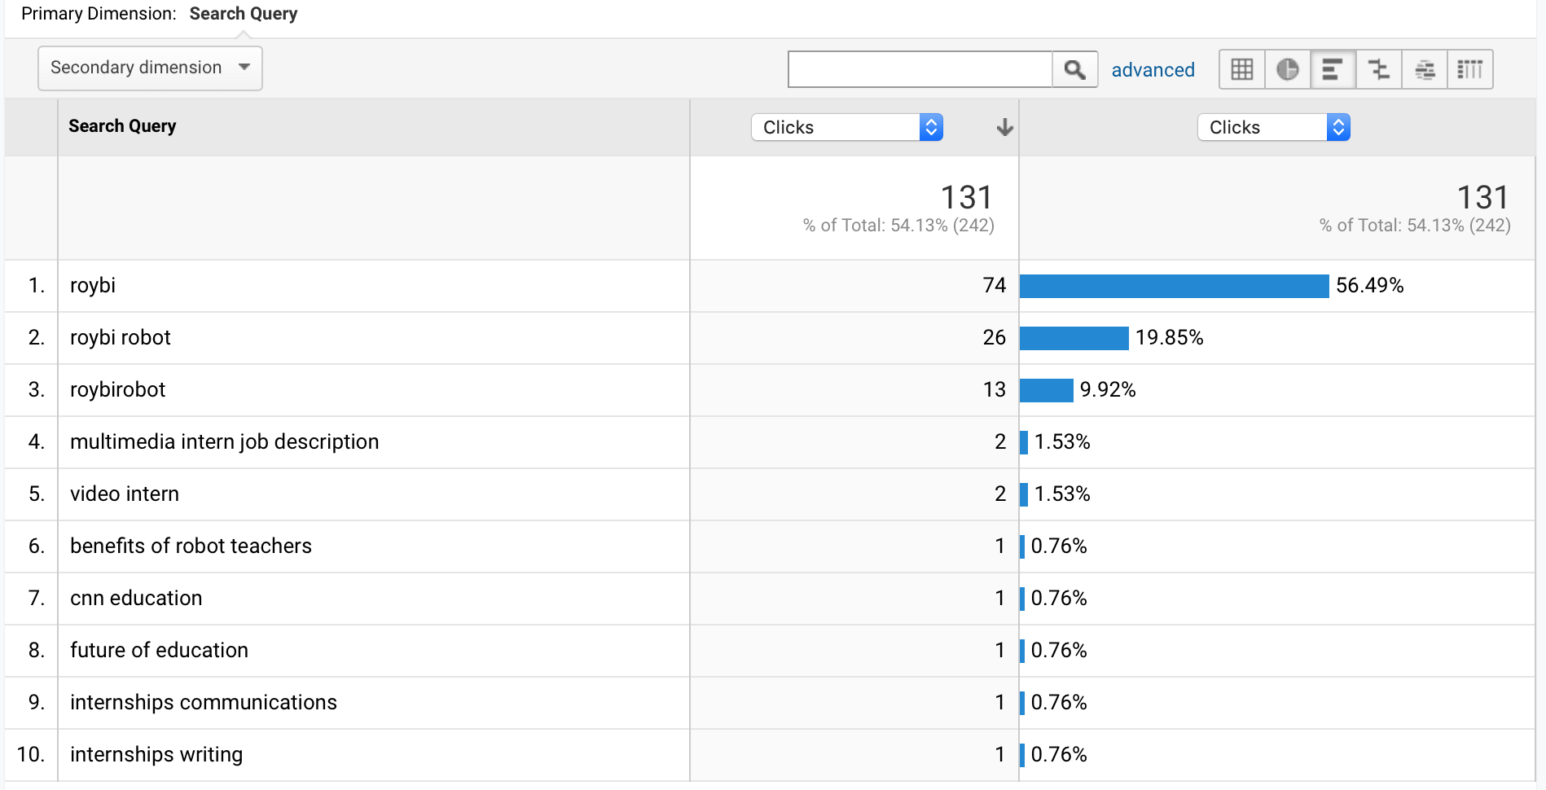
Our Main Issue : Low Brand Awareness
Very Small User Base
Visitors are all aware of Brand
86%
Low Brand Awareness

Slide 4
Insight Summary
Brand Insight
Moms are usually
cautious decision makers
( Research + WOM )
Companion + Personalized Learning development
#1 social & interacting robot ,keep children away from digital devices
#2 Personalized
language teaching and learning development robot
Consumer Insight
Media Insight
Moms study products on search & spend most time on social
(1# penetration: search
+
1# time spent: Social)

Slide 5
Strategic Direction
Brand Insight
Moms are usually
cautious decision markers
( Research + WOM )
Companion + Personalized Learning development
#1 social & interacting robot ,keep children away from digital devices
#2 Personalized
language teaching and learning development robot
Consumer Insight
Media Insight
Promote our product
# in highlighting USP ( social : keep children away from digital devices+ personal language development robot)
#through social and search
To reach our TA and persuade them to buy our products
Moms study products on search & spend most time on social
(1# penetration: search
+
1# time spend: Social)

Slide 6
Strategy Implications
Goal
Channel
Task
# Build up Awareness
Social
Spreading WOM
# Drive Conversion
Search
Seize TA by keywords & content optimization

Slide 7
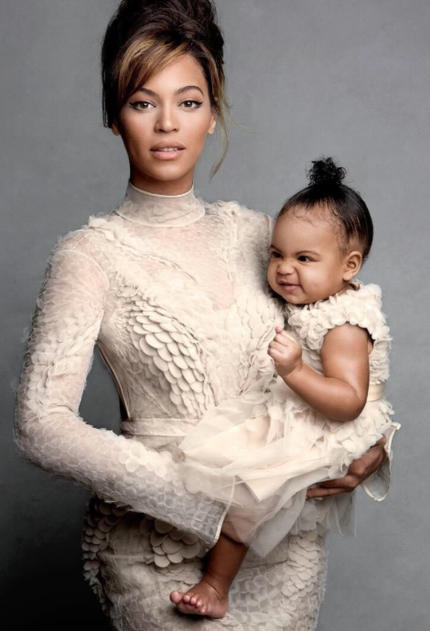
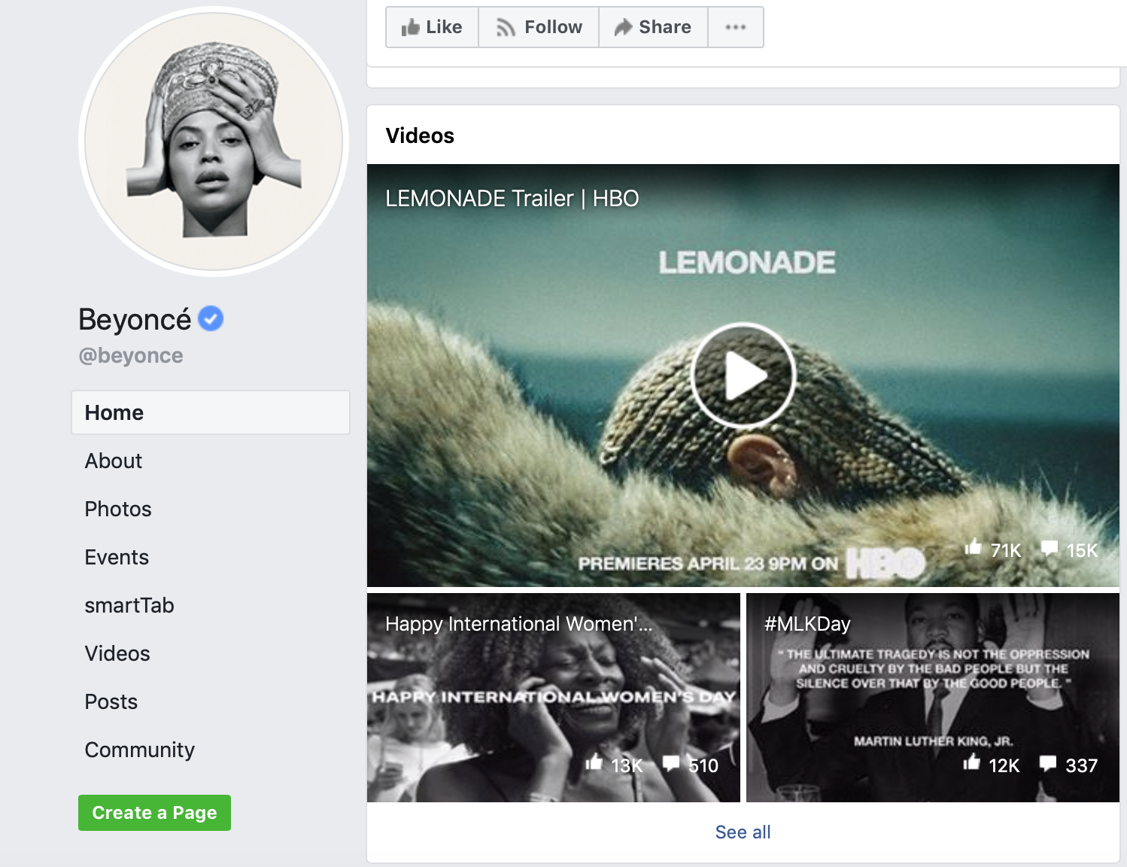
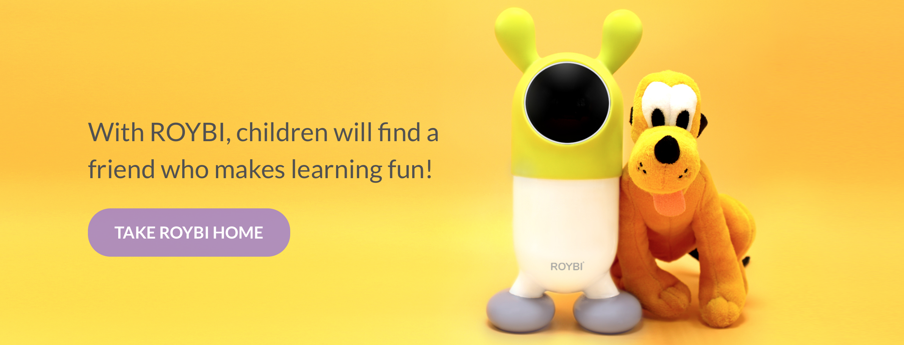
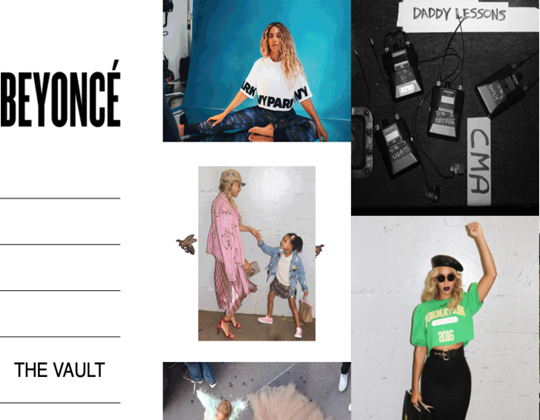
Awareness
Task 1 # Spread WOM on Social
2. Adaptive ad content linkage to their topic ; Place ads in the blog’s ad network and retarget TA
1. Invite Celebrity moms to post their product trial video with their kids
Notes:
Review their topics
Create ads relevant to their topics
Use the blog’s ad network to place ads in those blogs
Use remarketing

Slide 8
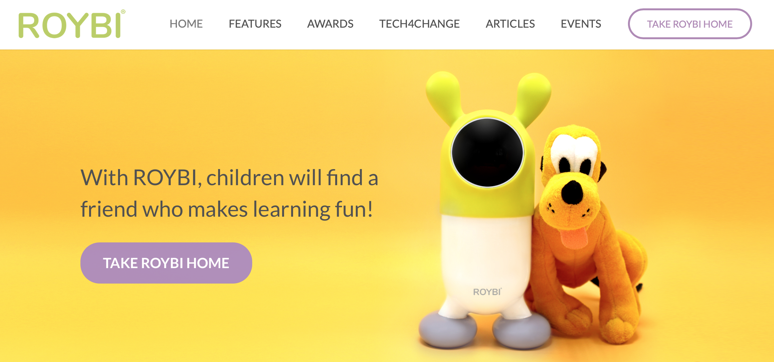
Awareness
Task 1 # Spread WOM on Social
Celebrity
1.Product trial videos
2.Adaptive ads retargeting
TA in the blog’s network
Moms
1.Encourage moms to post trial reviews
2. Sending Message of benefits
Brand
1. Establish Brand hub
(e.g. mom community)
2.But awards & Best robots on social front page
Notes:
Review their topics
Create ads relevant to their topics
Use the blog’s ad network to place ads in those blogs
Use remarketing

Slide 9
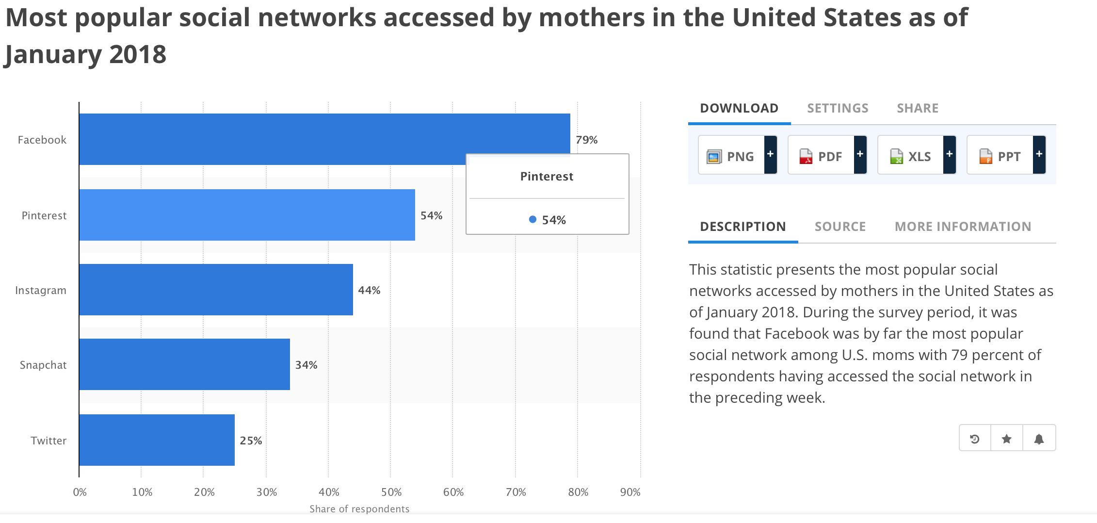
Task 1 # Spread WOM on Social
Awareness
1# Facebook is a must , if we have limited budget
2# Facebook plus Pinterest, if we have enough budget
Social Channel Suggestion:

Slide 10
Task 2# Search Optimization
Conversion
Seize TA by keywords & content optimization
Keywords Optimization : Subtask 1 & 2
Website Optimization : Subtask 3 & 4
#Keywords List
Find the related keywords to seize our TA
#Keywords Ad Content
Promote the appropriate keyword ad content
#Web Search Ranking
Make our website easily searchable
#Web Layout Optimization
Optimize website content

Slide 11
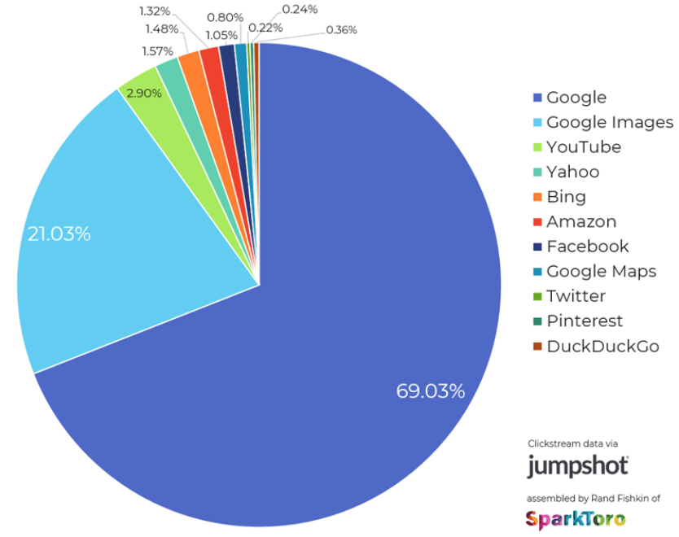
Task 2# Search Optimization
Conversion
US Mom Search Engine Market Share 2018
#Only invest on Google is
enough on search media
investment
Search Channel Suggestion:

Slide 12
Summary
GOAL
CHANNEL
TASK
KPI
Build up Awareness
Social
Spreading
WOM
IMP/CPM
ENGAGEMENT
( LIKE/FORWARD/
COMMENT/POST)
Drive Conversion
Search
Seize TA by keywords & content optimization
CLICKS/CPC
Vital Media KPI : CPL/CPA on each channel
Client Sales/EC KPI : AOV/AOS/CLV

Slide 13
Media Calendar
AUG.
SEP.
OCT.
NOV.
DEC.
Phase 1: Awareness
Phase 2: Conversion
Social
Test
Launch
Burst 1
Burst 2
Burst 3
Test
Launch
Search
NOV.22
Black Friday
DEC.25
Christmas
NOV.28
Thanksgiving
DEC.31
New Year’s Eve

Slide 14
Budget Recommendation(Yearly)
Option 1:
Limited Budget
Option 2:
Enough Budget
GOOGLE
$8100
$27000
GOOGLE-TEST
$900
$3000
FACEBOOK
$8100
$13500
FB-TEST
$900
$1500
PINTEREST
/
$13500
PINTEREST-TES
/
$1500
TOTAL
$18000
$60000

Slide 15
Appendix

Slide 16
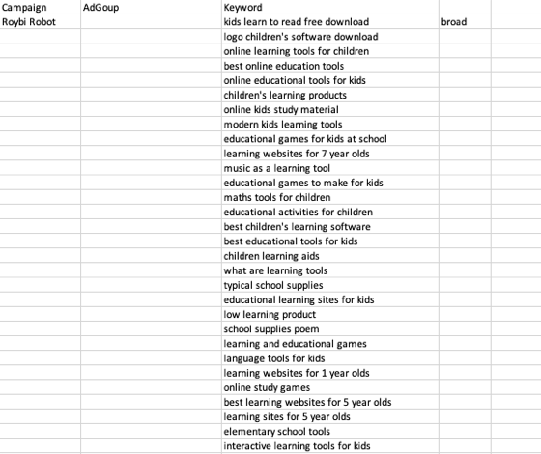
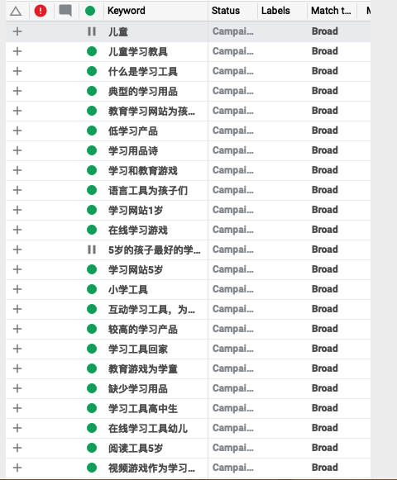
Keyword ad content
English keywords
Chinese keywords
Notes:
Promote the appropriate keyword ad content

